Slide 1
CUPED for faster AB-testing
Drambian David
Notes:
We’re here to talk about this miraculous technique called CUPED.
And, hopefully, by the end of this half-an-hour you’ll be able to run tests faster and cheaper and be real OGs.

Slide 2


What is an AB-test?
Control
Treatment

Slide 3
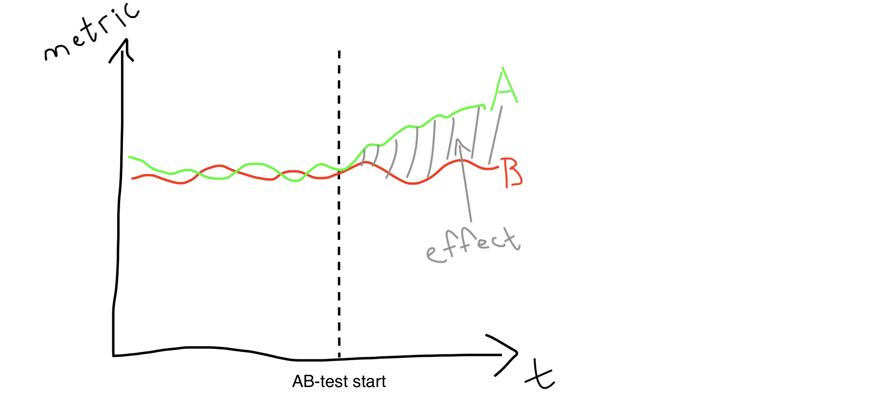
What happens in an ideal world?
A - treatment
B - control

Slide 4
In other words, …
Run a test
Accumulate enough data
Calculate the effect
Evaluate if it’s significant
Notes:
In an ideal world, we run a test, wait to accumulate enough data, calculate this effect, evaluate if the effect is significant.
Make a judgement on the test results.

Slide 5
In other words, …
Run a test
Accumulate enough data ⚡⚡⚡
Calculate the effect
Evaluate if it’s significant
Notes:
However, in real world there’re a lot of ifs and buts. And THIS STEP might cause a lot of issues that we might want to solve.
We want to accumulate enough data AS FAST AS POSSIBLE.
That is, we want to decrease our sample size AS MUCH AS POSSIBLE.

Slide 6



Why decrease sample size?
Short on time
Short on money
Not enough users
Notes:
Save time (to spend it with friends, of course)
Save money
Not enough users (a new app or product or …)
Moreover, if the treatment has a negative effect, we want to lose as little users as possible

Slide 7
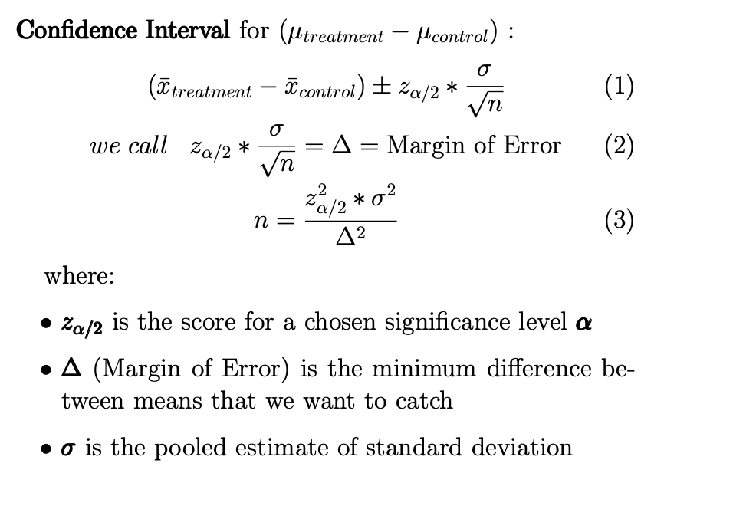
Minimum sample size
Notes:
We know how the CI looks like for difference in means. If you don’t, just trust me on this. Or, better, take a statistics class.
Assume equal variances and sample sizes (n_x and n_y) case for simplicity. Idea is the same otherwise as well.

Slide 8
Minimum sample size
Notes:
By simple permutation we derive this guy (n) from the previous equality.

Slide 9
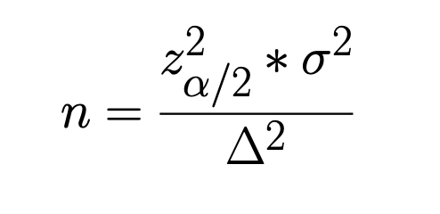
How to decrease Sample Size?
⬆ Margin of Error (Δ)
⬇ Variance (σ ²)
Make the test ‘weaker’ ⇒
⬆ Significance Level (𝛼) ⇒
⬇ Score’s Abs. Value (|z_{𝜶/2}|)
Notes:
Significance Level is the probability of I type error ⇔ probability of False Positive result.

Slide 10

How to decrease Sample Size?
⬆ Margin of Error (Δ)
⬇ Variance (σ ²)
Make the test ‘weaker’ ⇒
⬆ Significance Level (𝛼) ⇒
⬇ Score’s Abs. Value (|z_{𝜶/2}|)
Notes:
Margin of Error
This is tricky, because we basically hope that the treatment has any impact. And changing Margin of Error seems like a deeper and less obvious task. It is possible and it is efficient since MoE is squared so the impact is squared, but w can talk about that another time.

Slide 11

How to decrease Sample Size?
⬆ Margin of Error (Δ)
⬇ Variance (σ ²)
Make the test ‘weaker’ ⇒
⬆ Significance Level (𝛼) ⇒
⬇ Score’s Abs. Value (|z_{𝜶/2}|)
Notes:
Variance
This IS possible. And that’s what we’re going to try to do.

Slide 12

How to decrease Sample Size?
⬆ Margin of Error (Δ)
⬇ Variance (σ ²)
Make the test ‘weaker’ ⇒
⬆ Significance Level (𝛼) ⇒
⬇ Score’s Abs. Value (|z_{𝜶/2}|)

Slide 13
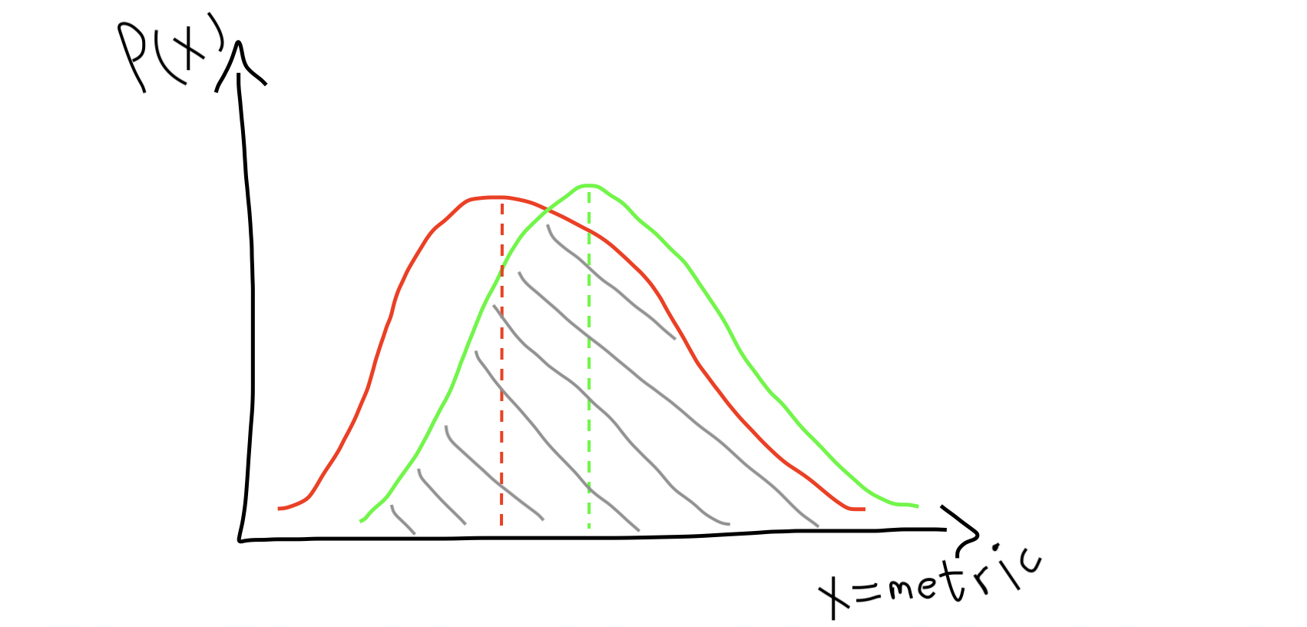
Intuition behind decreasing variance
High variance
Notes:
Even though we can have a decent difference in means, HIGH VARIANCE can still cause us troubles.
Distributions are hard to distinguish from one another

Slide 14
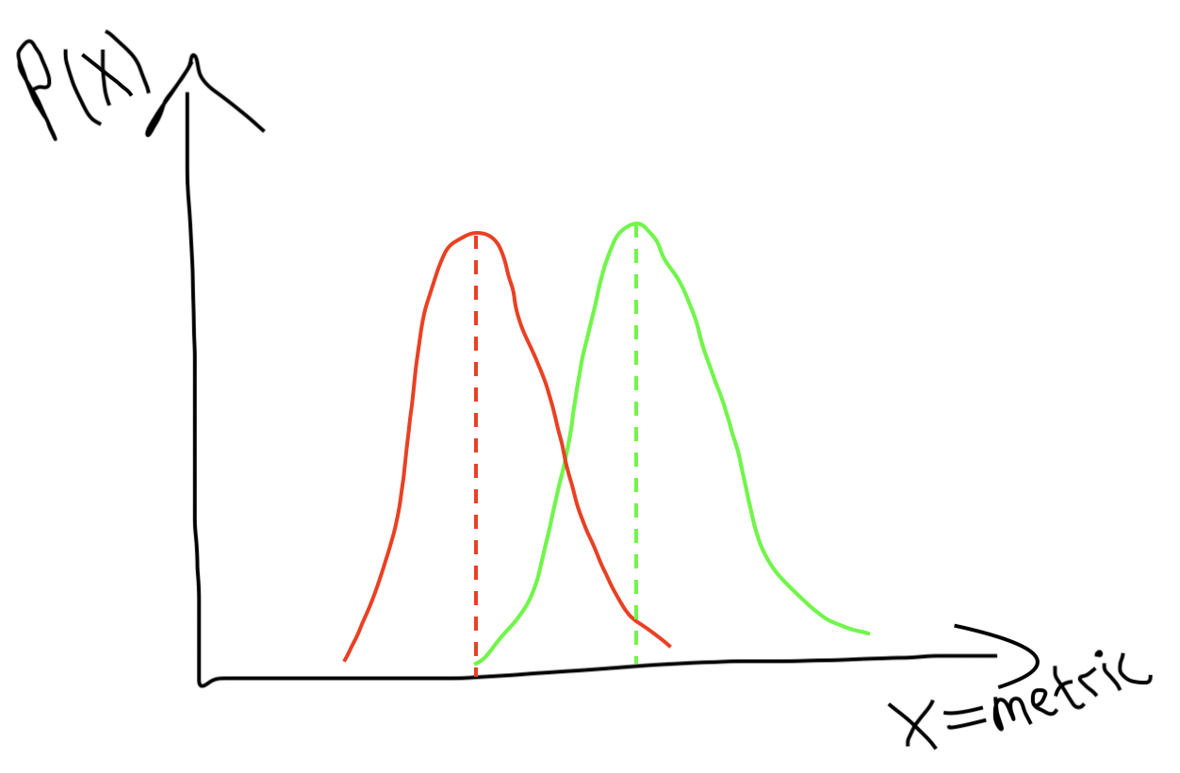
Intuition behind decreasing variance
High variance
Low Variance
Notes:
However, if we lower the variance, they become much more distinguishable.

Slide 15

Introducing CUPID CUPED
Controlled experiment Using Pre-Existing Data
Take a covariate X independent of the experiment
Y_{CUPED} = Y - 𝜃X
Notes:
Basically, we want to take a variable X that is not affected by the experiment. For example, just take one from before the experiment start.
Then, our desired CUPED-metric is the original metric, adjusted by this X and some parameter \theta

Slide 16
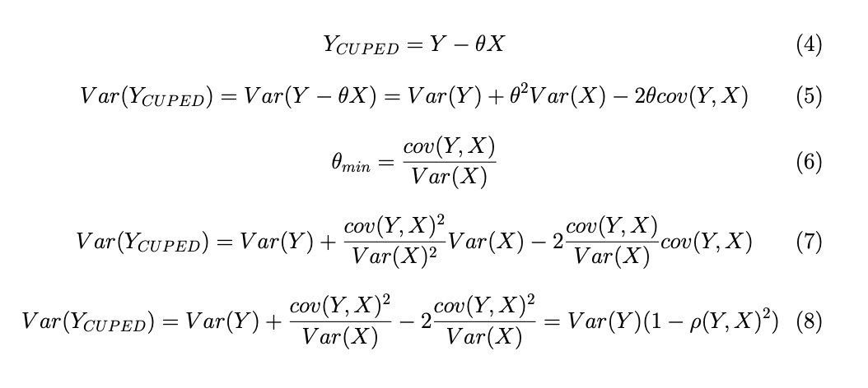
What happens to the Variance?
Notes:
Now the tricky part. If Y and X are independent, what happens to the Var?
Correct. Cov = 0. And Var does not decrease.

Slide 17
What happens to the Variance?
Trick: choose X such that it is dependant on Y, but independent on the experiment
Notes:
So the trick is to choose X such that it is dependant on Y, but independent on the experiment

Slide 18
What happens to the Variance?
Notes:
Now we can calculate parameter \theta that minimizes the Var(Y_{CUPED}). This is a school formula for parabola’s minimum (x_{min} = -b/(2a)).
And substitute it into the Var(Y_{CUPED}) formula.
We get …

Slide 19
What happens to the Variance?
Notes:
Voila. The desired Variance of Y_{CUPED}.
You can clearly see: the higher the correlation between Y and X, the lower the Variance.

Slide 20
Intuition behind CUPED
The covariate absorbs part of the Variance of Y, without affecting the experiment
Notes:
The Variance of Y depends on the covariate and other factors.
Get rid of the part of Variance, that depends on the covariate.

Slide 21
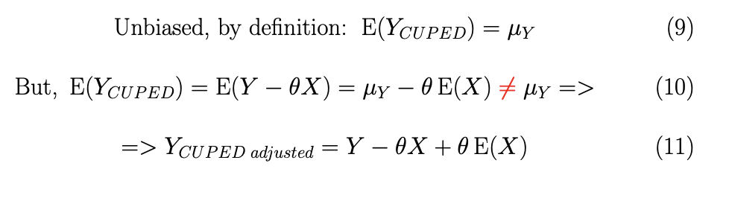
* Making Y_{CUPED} unbiased
Notes:
BUT! We need to make a tiny adjustment.
The problem with this Y_{CUPED} is that it is BIASED. Look…

Slide 22

* Making Y_{CUPED} unbiased
Notes:
So, to fix the bias, we basically adjust this Y_{CUPED} by the residing value and we get…

Slide 23
* Making Y_{CUPED} unbiased
Notes:
Where \E(X) in our case is just the mean of a covariate.
This Y_{CUPED adjusted} is an UNBIASED estimator for Y, which has the same Variance as Y_{CUPED}, which is lower or equal than Var(Y).
*** NOTE: *** this adjustment is not a must, but it makes the metric unbiased. In fact, Microsoft and Netflix use the unadjusted version: Y_{CUPED} = Y - \theta X
(source: https://booking.ai/how-booking-com-increases-the-power-of-online-experiments-with-cuped-995d186fff1d (‘At Booking.com, we implement…’))

Slide 24
How to choose a covariate?
Absorbs the most variance of our metric (Y)
Is independent from the experiment
Notes:
Two main principles.
An example of a covariate can be just historic values of the metric from the past.

Slide 25
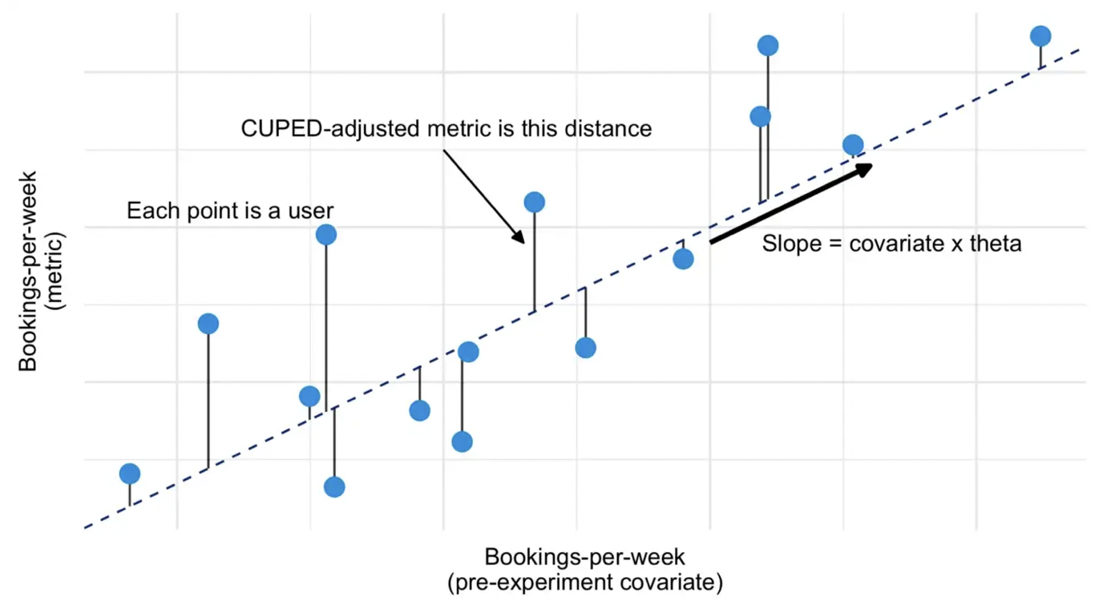
How to choose a covariate?
https://booking.ai/how-booking-com-increases-the-power-of-online-experiments-with-cuped-995d186fff1d
Notes:
If you think about the connection between the metric and historic metric (here’s an example from one of the original articles by Booking.com), what you want to do is just approximate this connection with a slope and have new CUPED-adjusted metrics as the residuals.
In fact, you are not restricted to using a linear function. Theoretically, you can train a boosting algorithm on historic data and use it as a covariate.

Slide 26
Let’s practise
https://colab.research.google.com/drive/1M6B2jWZkRFe-g8_MYlAng3rKwq4sSwBa?usp=sharing

Slide 27
What we’ve learned?
Decrease test sample size to save ⏰, 💰 and 👤
Use CUPED with covariate
Independent on experiment
Correlated with metric
Absorb metric variance with covariate
Have fun!
Notes:
You want to run tests faster to save time, money and users.
And CUPED turns out to be a very cool tool for that.
Doing so, we decrease the variance of the metric.
And you’re golden.

Slide 28




Be cool like him
dav1ddramb
<confidential-email>@gmail.com
@halftimestat
Notes:
So, have fun, be efficient and optimize your tests.
It was a pleasure.

Slide 29
Useful links
https://www.researchgate.net/publication/237838291_Improving_the_Sensitivity_of_Online_Controlled_Experiments_by_Utilizing_Pre-Experiment_Data
https://www.kdd.org/kdd2016/papers/files/adp0945-xieA.pdf
https://towardsdatascience.com/how-to-double-a-b-testing-speed-with-cuped-f80460825a90
https://booking.ai/how-booking-com-increases-the-power-of-online-experiments-with-cuped-995d186fff1d

Slide 30
Other solutions
Stratification

Slide 31
LaTeX code
\documentclass{article}
\usepackage[utf8]{inputenc}
\usepackage{amsmath}
\usepackage[top=30pt,bottom=30pt,left=48pt,right=46pt]{geometry}
\usepackage{xcolor}
\DeclareMathOperator{\EX}{\mathbb{E}}
\title{CUPED for faster AB-testing}
\author{DD}
\date{December 2022}
\begin{document}
\maketitle
\section{Introduction}
\begin{Large}
\pmb{Confidence Interval} for $(\mu_{treatment} - \mu_{control})$ :
\begin{gather}
(\Bar{x}_{treatment} - \Bar{x}_{control}) \pm z_{\alpha/2}*\frac{\sigma}{\sqrt{n}} \\
we\;call\;\;\; z_{\alpha/2}*\frac{\sigma}{\sqrt{n}} = \Delta = \text{Margin of Error} \\
n = \frac{z_{\alpha/2}^2 * \sigma^2}{\Delta^2}
\end{gather}
where:
\begin{itemize}
\item \pmb{$z_{\alpha/2}$} is the score for a chosen significance level \pmb{$\alpha$}
\item \pmb{$\Delta$} (Margin of Error) is the minimum difference between means that we want to catch
\item \pmb{$\sigma$} is the pooled estimate of standard deviation
\end{itemize}
\end{Large}
\setlength{\jot}{15pt}
\section{CUPED}
\begin{Large}
\begin{gather}
Y_{CUPED} = Y - \theta X \\
Var(Y_{CUPED}) = Var(Y - \theta X) = Var(Y) + \theta^2 Var( X) - 2\theta cov(Y, X) \\
\theta_{min} = \frac{cov(Y, X)}{Var(X)} \\
Var(Y_{CUPED}) = Var(Y) + \frac{cov(Y, X)^2}{Var(X)^2} Var( X) - 2\frac{cov(Y, X)}{Var(X)} cov(Y, X) \\
Var(Y_{CUPED}) = Var(Y) + \frac{cov(Y, X)^2}{Var(X)} - 2\frac{cov(Y, X)^2}{Var(X)} = Var(Y)(1-\rho(Y, X)^2)
\end{gather}
\end{Large}
\setlength{\jot}{20pt}
\section{Unbiased CUPED}
\begin{LARGE}
If we want $Y_{CUPED}$ to be unbiased:
\begin{gather}
\text{Unbiased, by definition: } \EX(Y_{CUPED}) = \mu_{Y} \\
\text{But, } \EX(Y_{CUPED}) = \EX(Y - \theta X) = \mu_Y - \theta \EX(X) \color{red} \neq \color{black}\mu_Y => \\
=> Y_{CUPED\;adjusted} = Y - \theta X + \theta \EX(X)
\end{gather}
\end{LARGE}
\end{document}

